Slide 1
ENabling SafE Multi-Brand Platooning for Europe
Marika Hoedemaeker, TNO, March 26, 2019

Slide 2
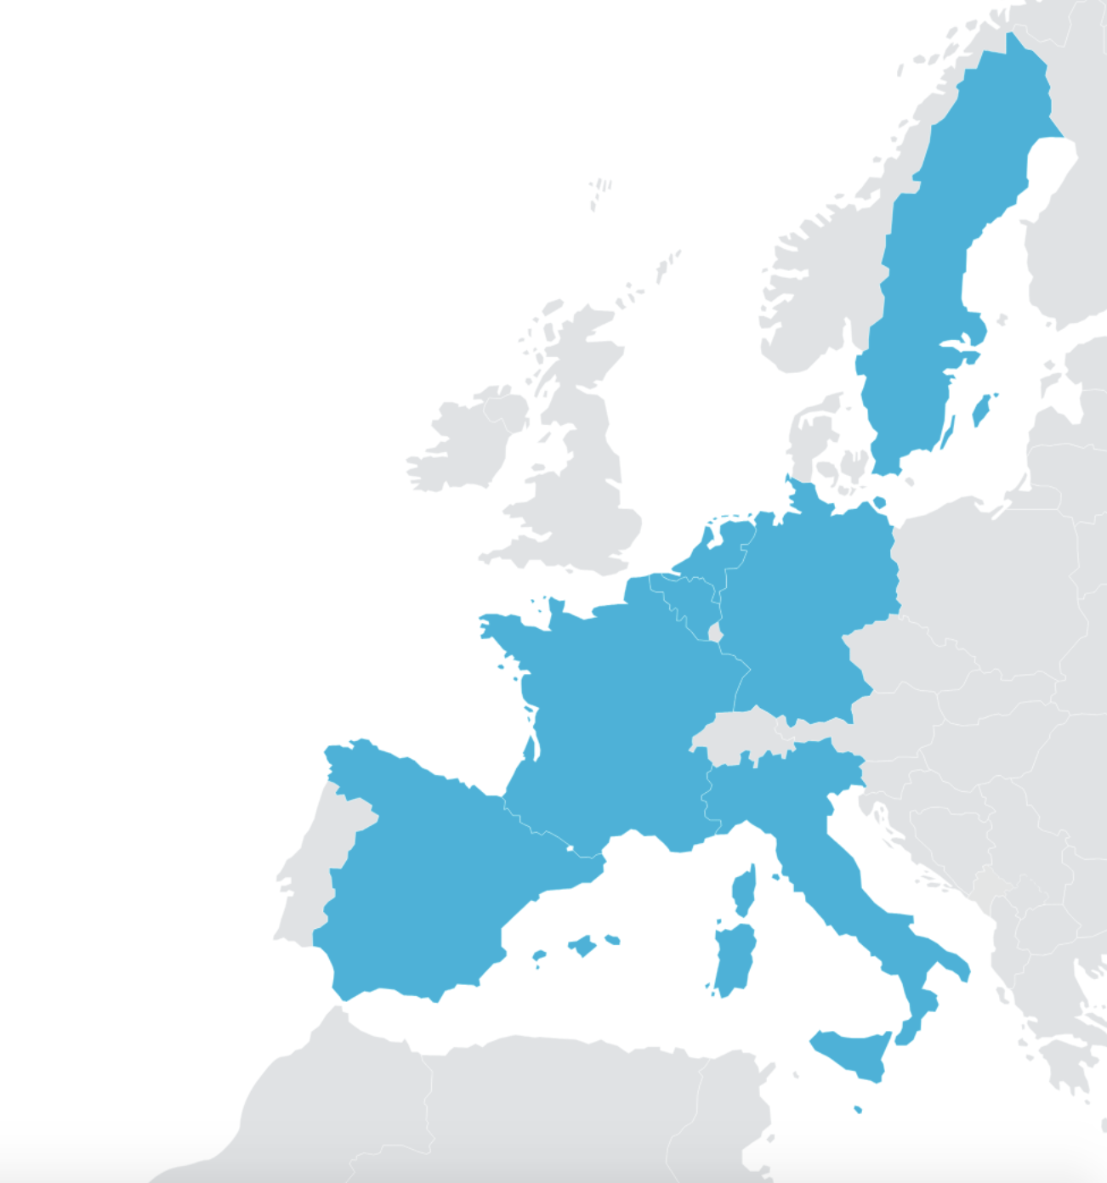
ENSEMBLE facts
The ENSEMBLE project is coordinated by TNO in collaboration with:
Innovation Action no. 769115
3 year EU project, started June 1st 2018
20 million euro EC funding
20 partners, representing the full value chain of the automotive sector
The European truck manufacturers: DAF, DAIMLER, IVECO, MAN, SCANIA, VOLVO Group (Volvo trucks and Renault trucks)
CLEPA represents the European suppliers of automotive equipment and components.
Suppliers: Bosch, Brembo, Continental,
Daimler Fleetboard, NXP, WABCO, ZF .
ERTICO: Link to the European Truck Platooning Community.
Knowledge partners: IDIADA, IFSTTAR, KTH, VU Brussel.

Slide 3
Truck platooning and ENSEMBLE
Societal impact:
Truck platooning holds a potential to improve road safety, reduce emissions and increase transport efficiency.
To achieve the next step towards deployment, an integral multi-brand approach is required.
Ambition ENSEMBLE:
Focus on the harmonisation of multi-brand specification, realising a Multi-brand V2V communication protocol supporting all platooning levels, leading to standards for multi-brand truck interoperability.
Platooning Levels
The project has defined different platooning levels to break down the complexity of multi-brand platooning into manageable steps towards deployment.

Slide 4
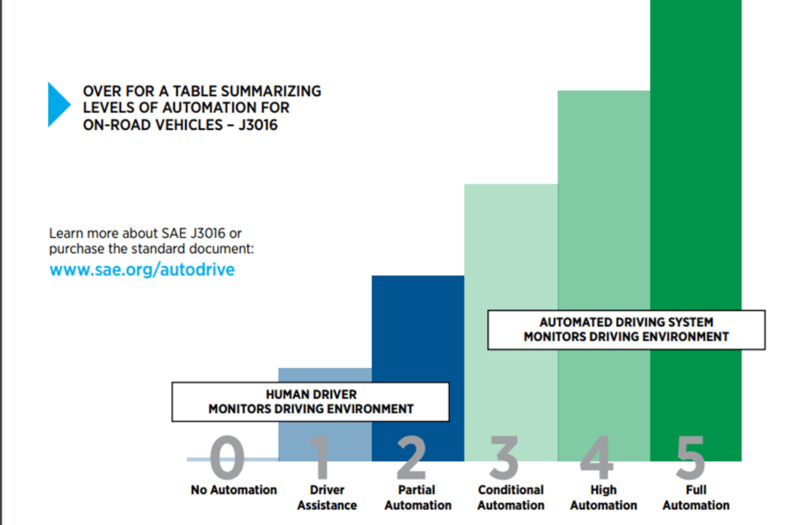
SAE automation levels
Not a perfect fit for describing platooning being a system-of-systems
Operational and managerial independence
Evolutionary development
ENSEMBLE has defined the notion of platooning levels
Level A/B/C
Break down the complexity of platooning

Slide 5
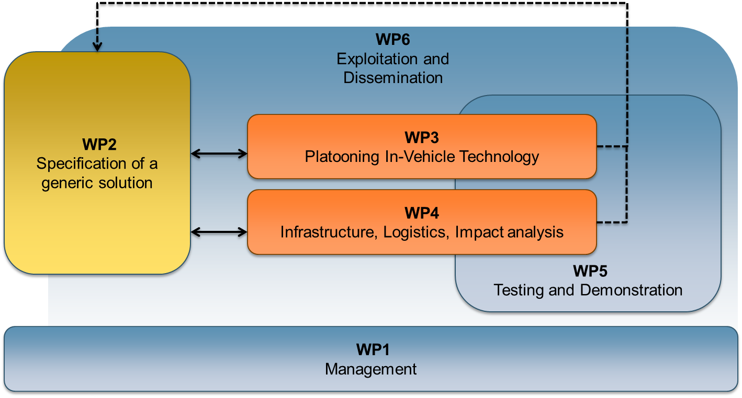
Project structure

Slide 6
WP3 Platooning Technology
Objectives:
Design and implementation of a platooning system according to the specifications of WP2
Develop the common functionality that is required for multi-brand platooning:
platoon coordinator functionality
mechanism to check consistency of the messages
functionality to guarantee safe behavior of the platoon
The implementations will be verified in WP5 against the specifications and requirements given in WP2

Slide 7
WP3 Platooning technology
Communication unit: box delivered with first message set, access to updates, test tool.
Security tested @ETSI plug test
Platoon coordinator functionality: setting up HIL & implementing first use cases
Each OEM: communication testing, working on trucks, setting up teams for 2-brand platoon testing

Slide 8
WP4 Impacts of multi-brand platooning
Objectives:
Assessment of the impact of multi-brand platooning on:
Road infrastructure (pavement, bridges, tunnels)
Economic and environmental benefits,
Truck drivers & other road users
Traffic conditions and traffic flow
Assessment of the variability of these impacts:
Variability in loads and dimensions
Formation of platoons on the fly

Slide 9
WP5 Testing and Demonstration
Objectives:
Technical evaluation of the generic multi-brand platooning solution
Definition of methodology and test plan; incl. data acquisition plan and KPI’s
Validation of the generic solution via physical tests on test tracks
Multi-brand platooning testing on public roads
Demonstration of the multi-brand platoon solution on public roads

Slide 10
Important Milestones
2021
2020
2019
April:
Multibrand platooning test tracks
November:
Impact: results on business model and market needs
February:
Impact: effects of platoons on infrastructure
2018
February:
Definition of specifications
August:
Communication functions & SW ready for implementation
May 2021:
Closure with public demo
June:
Kick off

Slide 11
Results and deliverables so far
Deliverables submitted:
Requirements review from EU projects (D2.1)
Description of Level A platooning (D2.2)
Specifications of white label truck (D2.4)
Specifications of intelligent infrastructure communication (D2.6)
Platooning protocol definition, communication strategy (D2.8)
Iterative process document and “item definition”(D2.10)
Dissemination and communication plan (D6.1)
Ensemble Letter of Intent (D6.7)
Regulatory framework – state of the art (D6.10)
Near future deliverables:
Security framework of platooning (D2.9, May)
SOTIF safety concept (D2.13, May)

Slide 12
Thank you for your attention
platooningensemble.eu
Consortium leader Marika.hoedemaeker@tno.nl

