Slide 1
ENabling SafE Multi-Brand Platooning for Europe

Slide 2
About ENSEMBLE

Slide 3
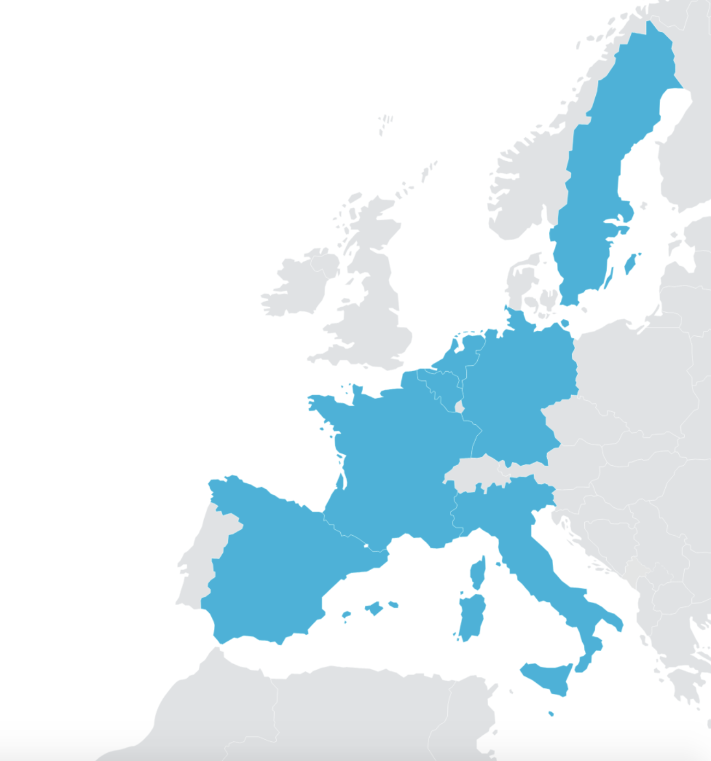
ENSEMBLE facts
The ENSEMBLE project is coordinated by TNO in collaboration with:
Innovation Action no. 769115
3 year EU project, started June 1st 2018
20 million euro EC funding
20 partners, representing the full value chain of the automotive sector
The European truck manufacturers: DAF, DAIMLER, IVECO, MAN, SCANIA, VOLVO Group (Volvo trucks and Renault trucks)
CLEPA represents the European suppliers of automotive equipment and components.
Suppliers: Bosch, Brembo, Continental,
Daimler Fleetboard, NXP, WABCO, ZF .
ERTICO: Link to the European Truck Platooning Community.
Knowledge partners: IDIADA, IFSTTAR, KTH, VU Brussel.

Slide 4
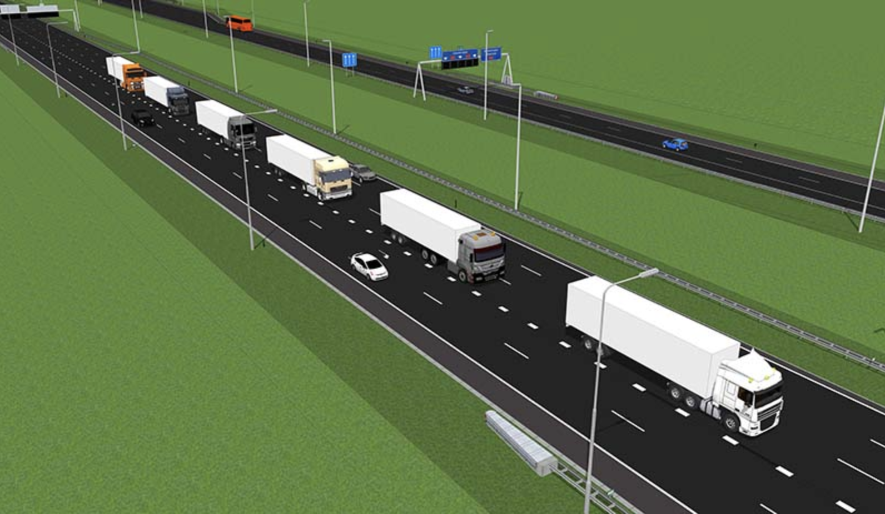
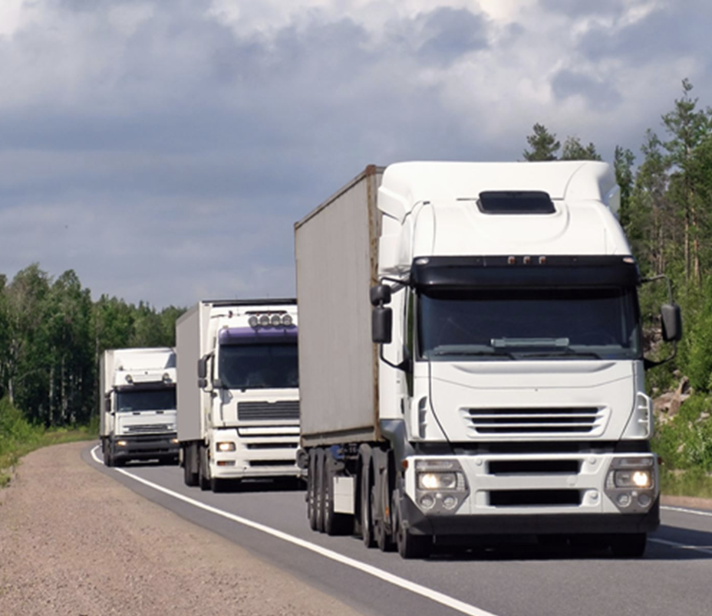
Project objectives
To pave the way for the adoption of multi-brand truck platooning in Europe, by
Aligning and working on standardization
Implementing Platooning Level A for deployment .
Demonstrating up to 7 differently branded trucks in one platoon
Under real world traffic conditions
Across (national) borders
Assessing impacts on traffic safety, throughput and fuel economy

Slide 5
Truck platooning and ENSEMBLE
Societal impact:
Truck platooning holds a potential to improve road safety, reduce emissions and increase transport efficiency.
To achieve the next step towards deployment, an integral multi-brand approach is required.
Ambition ENSEMBLE:
The harmonisation of multi-brand specifications, realising a Multi-brand V2V communication protocol supporting all platooning levels, leading to standards for multi-brand truck interoperability.
Platooning Levels
The project has defined different platooning levels to break down the complexity of multi-brand platooning into manageable steps towards deployment.

Slide 6
About Platooning levels

Slide 7
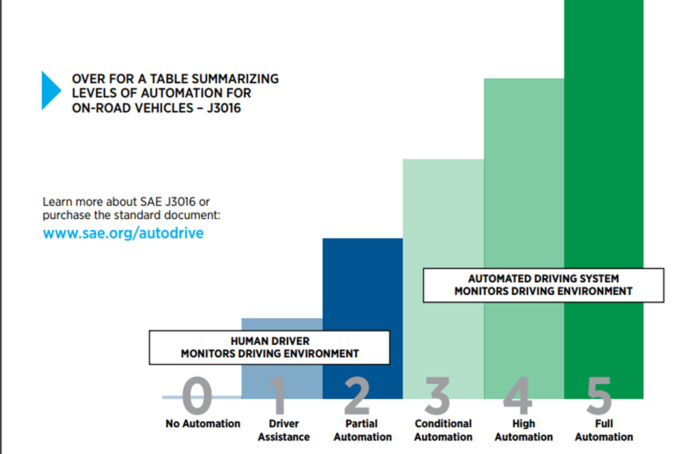
SAE automation levels
Not a perfect fit for describing platooning being a system-of-systems
Short inter-vehicle distances
Driver can not be held responsible for timely intervention
ENSEMBLE has defined the notion of platooning levels
Level A/B/C
Break down the complexity of platooning

Slide 8
Platoon level A definition
Definition for ready to market system:
System in Control *
of longitudinal functional safety
1
Longitudinal automation + fail operation
No lateral automation
2
New
?
Trailing
Following
Leading
4
New members can only engage from the rear
Following distance 0,8 & 1,4 s
This requires new
longitudinal functions (e.g. brake performance calculation)
Safety functions (e.g. redundant braking functions, additional sensors)
3
5
Benefits in terms of :
Fuel saving
Safety
Logistics

Slide 9
Platoon levels at a glance
Increasing level of automation
A
B
C
Automation: longitudinal
Leading: manual or advanced assistance; Following & trailing: autonomous longitudinal control
Automation: lateral
Driver &
In lane (optional)
In lane &
Lane change
Full automation
Operation area: dedicated area
triggered by driver (e.g. highway)
(e.g. highway)
(e.g. highway & parking area)
Engaging: from the rear
Single truck & existing platoon
Engaging: from front
Single truck
Single truck & existing platoon
Max. # of trucks
7 (max for simulation & verifications)
No principal technical limitations
Time gap
> 0,8
> 0,5
> 0,3
Monitoring: system
System itself
Monitoring: environment
driver
System itself
Fall back
driver
System in x seconds
system
Platoon formation possible
yes
yes
yes

Slide 10
About The Project

Slide 11
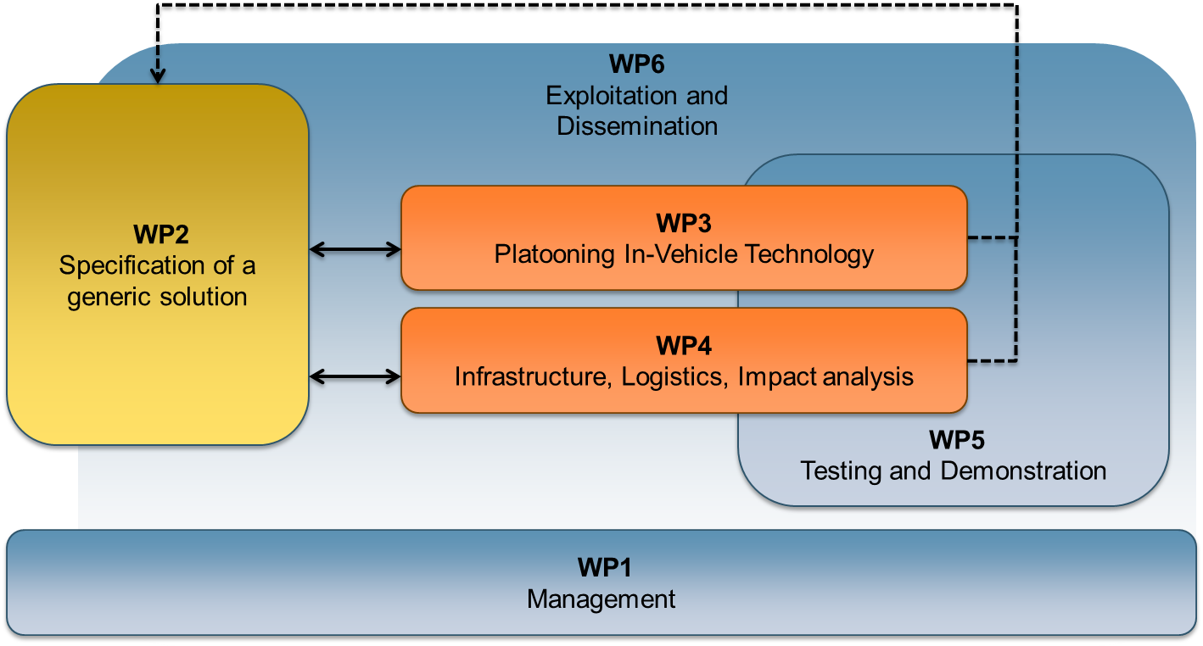
Project structure

Slide 12
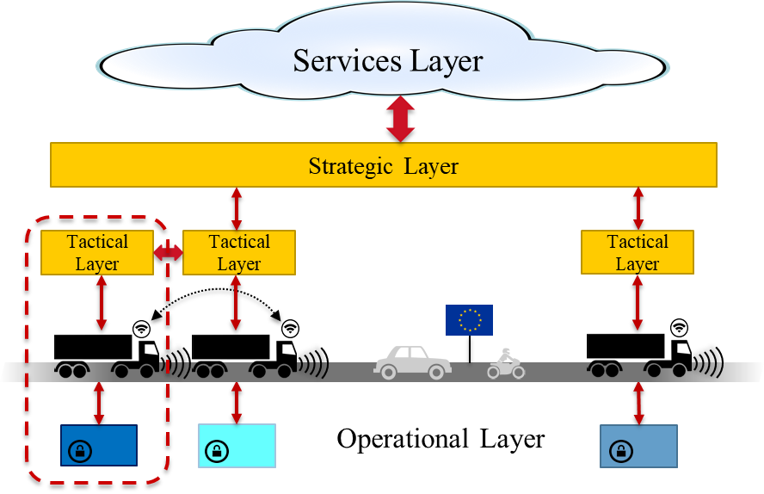
WP2 Specification of a generic solution
Objectives:
Definition of the specifications of the layers and their interfaces to be implemented within the demonstration trucks of the 6 OEMs
Specifications based on aligned use cases
Iterative process to validate and update the specification during the whole project life-cycle is an essential part of the work
Input for standardisation

Slide 13
WP3 Platooning Technology
Objectives:
Design and implementation of a platooning system according to the specifications of WP2
Develop the common functionality that is required for multi-brand platooning:
platoon coordinator functionality
mechanism to check consistency of the messages
functionality to guarantee safe behavior of the platoon
The implementations will be verified in WP5 against the specifications and requirements given in WP2

Slide 14
WP4 Impacts of multi-brand platooning
Objectives:
Assessment of the impact of multi-brand platooning on:
Road infrastructure (pavement, bridges, tunnels)
Economic and environmental benefits,
Truck drivers & other road users
Traffic conditions and traffic flow
Assessment of the variability of these impacts:
Variability in loads and dimensions
Formation of platoons on the fly

Slide 15
WP5 Testing and Demonstration
Objectives:
Technical evaluation of the generic multi-brand platooning solution
Definition of methodology and test plan; incl. data acquisition plan and KPI’s
Validation of the generic solution via physical tests on test tracks
Multi-brand platooning testing on public roads
Demonstration of the multi-brand platoon solution on public roads

Slide 16
About The Results

Slide 17
Important Milestones
2021
2020
2019
April:
Multibrand platooning test tracks
November:
Impact: results on business model and market needs
February:
Impact: effects of platoons on infrastructure
2018
February:
Definition of specifications
August:
Communication functions & SW ready for implementation
May 2021:
Closure with public demo
June:
Kick off

Slide 18
Main project deliverables
Functional specifications for different levels of multi-brand platooning
Inputs for standardization
Implementation of a reference design for the communication layer
Development, verification and validation of multi-brand platooning
Virtual and real life validation by simulation, on test tracks and public roads
Assessment of the economic and environmental impact
Demonstration of multi-brand platooning on public roads

Slide 19
Thank you for your attention
platooningensemble.eu
Consortium leader Marika.hoedemaeker@tno.nl

